Slide 1
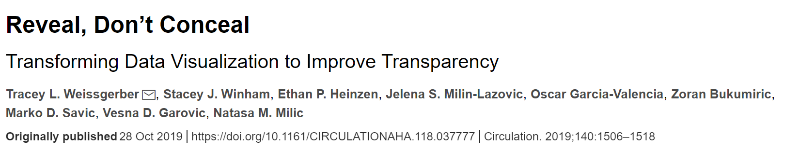


Reveal, Don’t Conceal
Raimondo Lab Journal Club
@ChrisCurrin
presents…
Also featuring
seaborn.pydata.org
data-to-viz.com
Notes:
Your work was tough, your results are special, they are important. The amount of care you put into making sure your results are right needs to be taken to make sure your results are understood and therefore have impact.

Slide 2
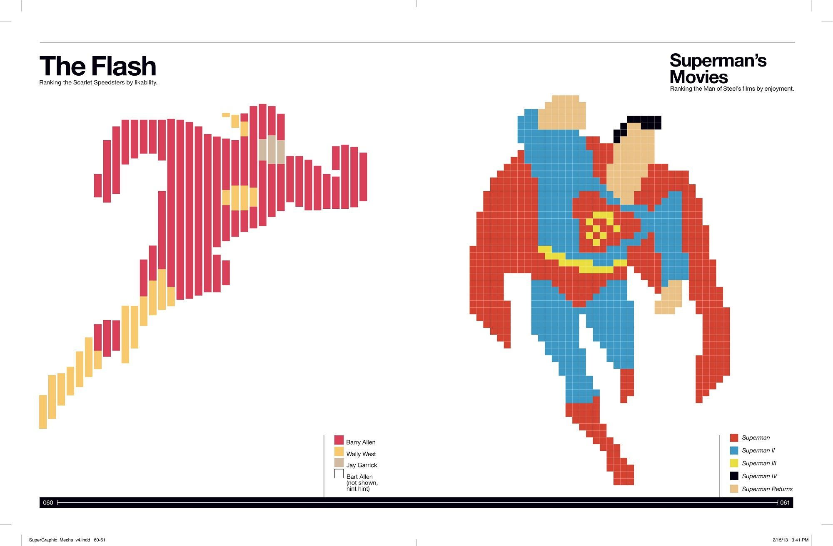

Slide 3
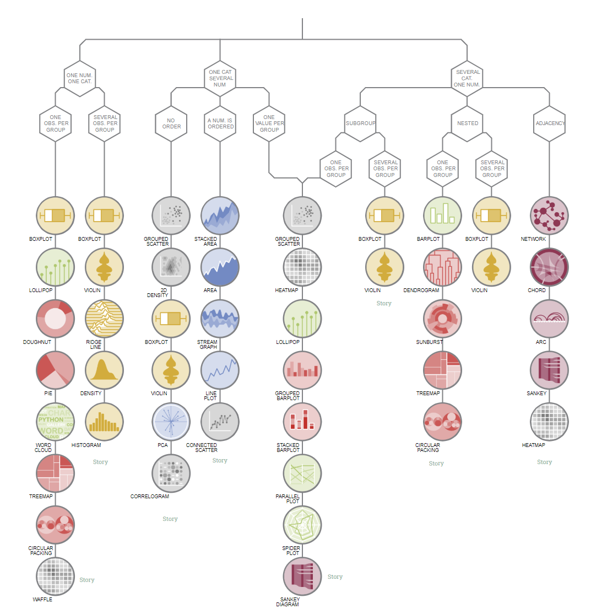

Slide 4




Outline
Chart type
Effective plots
Mixed messages
Resources & examples
outlining strategies for selecting the correct type of figure depending on the study design, sample size, and the type of variable
examining techniques for making effective dot plots, box plots, and violin plots
illustrating how to avoid sending mixed messages by aligning the figure structure with the study design and statistical analysis.
Resources include a list of free tools and templates that authors can use to create more informative figures and an online simulator that illustrates why summary statistics are meaningful only when there are enough data to summarize

Slide 5
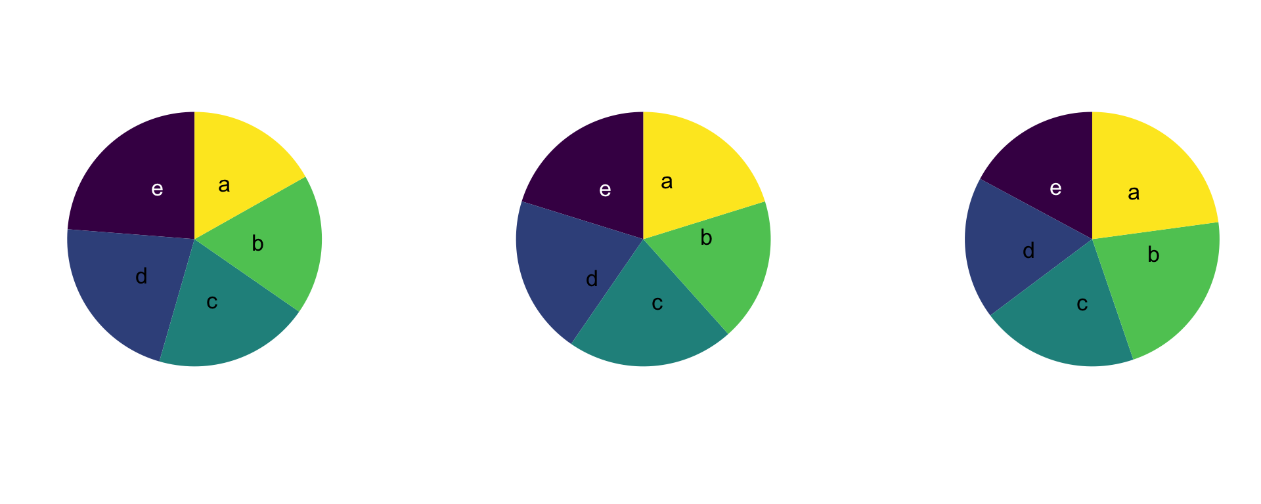
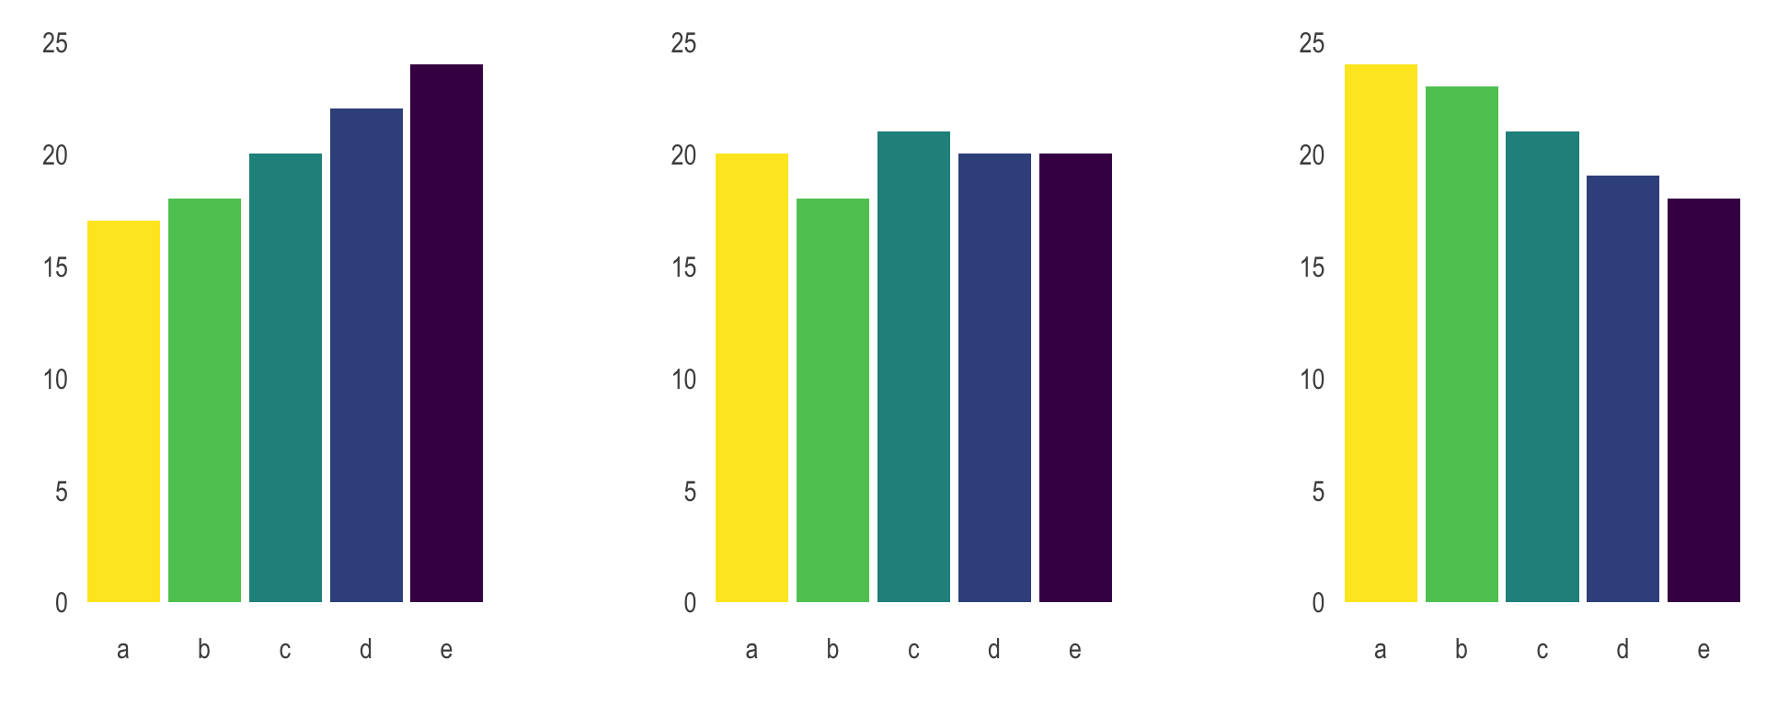
Chart types
Humble pie
A pie chart is a circle divided into sectors that each represent a proportion of the whole.
which group has the highest value in these 3 graphics.
what is the evolution of values among groups.

Slide 6
Chart types
Bar graph
It shows the relationship between a numerical variable and a categorical variable.
Often confounded with histograms, which is highly different. (It has only a numerical variable as input and shows its distribution).
Figure 1. Why one shouldn’t use a bar graph, even if the data are normally distributed.
Bar graphs arbitrarily assign importance to the height of the bar, rather than focusing attention on how the difference between means compares to the range of observed values.
A, The bar height represents the mean. Error bars represent 1 standard error. The y-axis starts at zero and ends just above the highest error bar.
B, Adding data points reveals that the bar graph in A includes low values that never occurred in the sample (“Zone of Irrelevance”) and excludes observed values above the highest error bar (“Zone of Invisibility”).
C, The dot plot emphasizes how the difference between means compares to the range of observed values. The y-axis includes all observed values.
Reprinted from Weissgerber et al²² under a CC-BY license. SE indicates standard error.

Slide 7
Chart Types - Categorical
Figure 2. Figures for comparing groups in cross-sectional or experimental studies.
When choosing among different types of graphs, it is important to consider
the study design,
sample size, and
data distribution.
Notes:
Figure 2. Figures for comparing groups in cross-sectional or experimental studies. When choosing among different types of graphs, it is important to consider the study design, sample size, and data distribution. This figure provides a detailed overview of different types of graphs, describes when to use each graph, and lists best practices for clear data presentation.

Slide 8
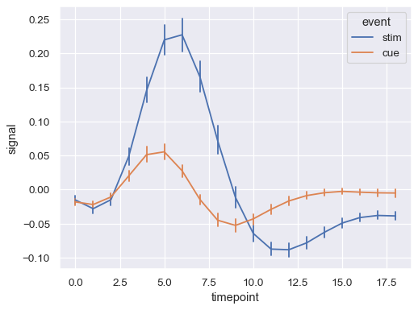
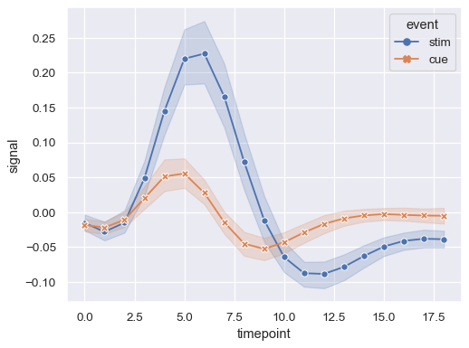
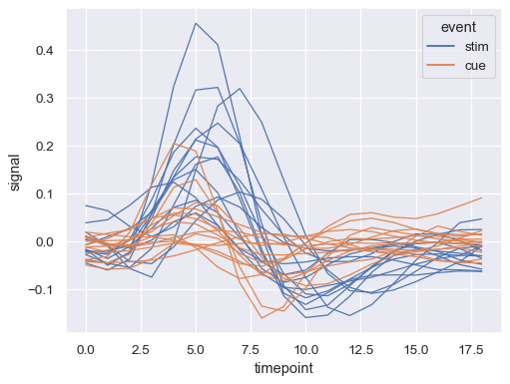
Chart types - relational
Line chart
A line chart or line graph displays the evolution of one or several numeric variables.
Data points are connected by straight line segments.
It is similar to a scatter plot except that the measurement points are ordered (typically by their x-axis value) and joined with straight line segments.

Slide 9

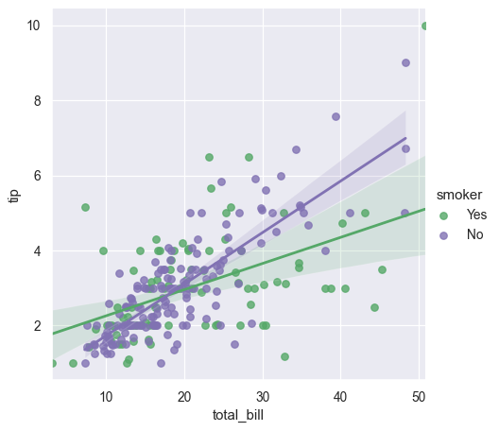
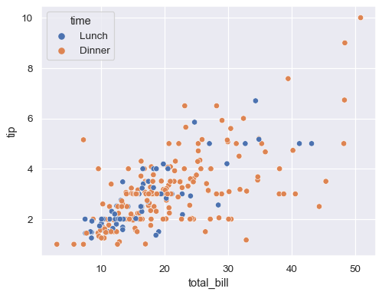
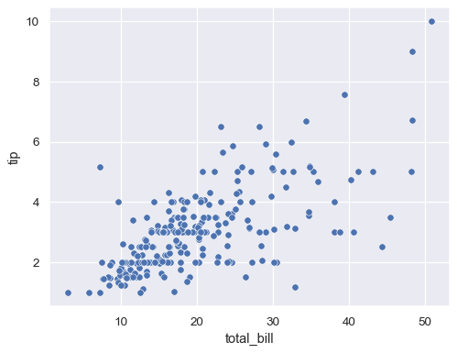
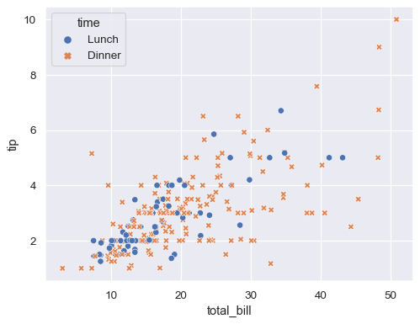
Chart types - relational
Scatter plot
The scatter plot is a mainstay of statistical visualization.
It depicts the joint distribution of two variables using a cloud of points, where each point represents an observation in the dataset.
This depiction allows the eye to infer a substantial amount of information about whether there is any meaningful relationship between them.

Slide 10

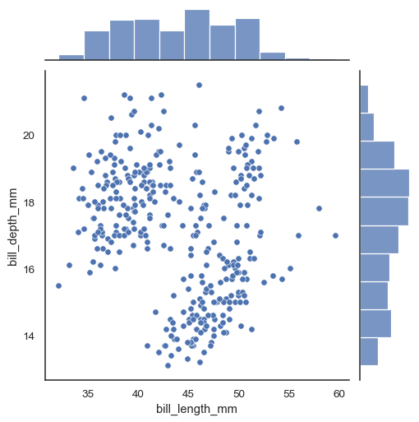
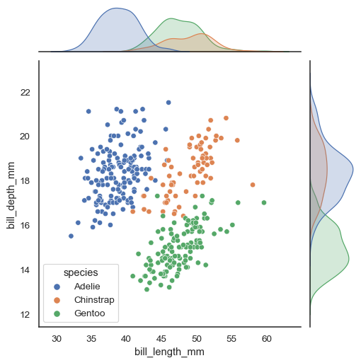
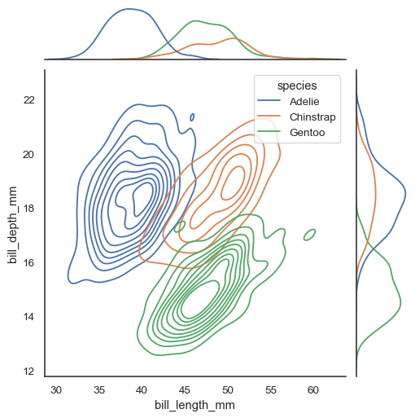
Chart types - relational
Scatter plot
The scatter plot is a mainstay of statistical visualization.
It depicts the joint distribution of two variables using a cloud of points, where each point represents an observation in the dataset.
This depiction allows the eye to infer a substantial amount of information about whether there is any meaningful relationship between them.

Slide 11
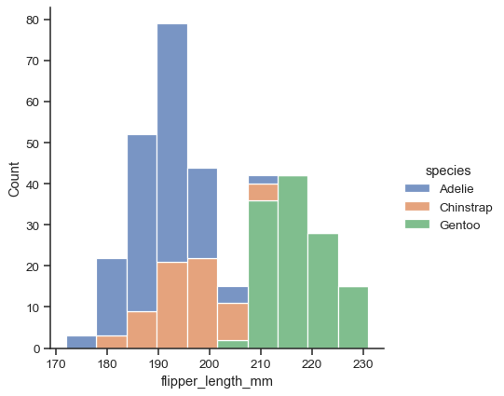
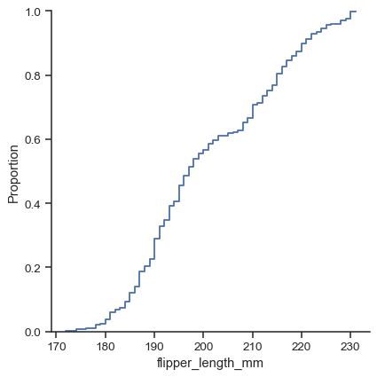
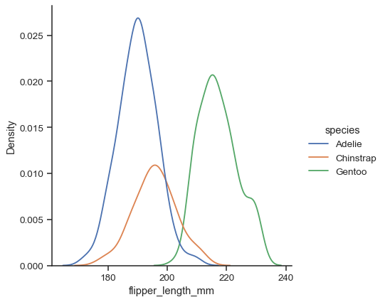
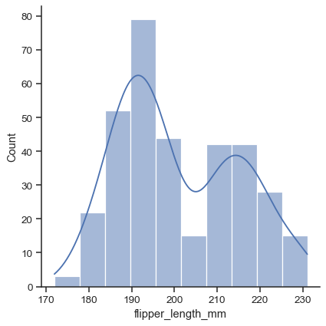
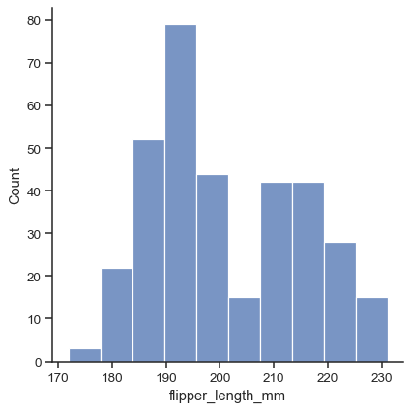
Chart types - distributional
Histogram & Density plot
An histogram is an accurate graphical representation of the distribution of numerical data.
It takes as input one numerical variable only.
The variable is cut into several bins, and the number of observation per bin is represented by the height of the bar.
Note that the shape of the histogram can be really different following the number of bins you set.
Thus, try different values before taking any conclusion.
To compare several distributions, plot on the same axes or use categorical plots

Slide 12
Effective plots
Figure 3. Strategies for making effective dot plots. The initial graph is hard to interpret because it has many overlapping data points (A).
Strategies for making all points visible include decreasing the size of the data points (B), making the data points semi-transparent (C), and using random (D) or symmetric (E) jittering.
The bottom row illustrates how to clearly show the main finding, while allowing readers to critically evaluate the data.
Increasing the white space between groups (G) and emphasizing the summary statistics (H) makes the graph (F) much easier to interpret.

Slide 13
Effective plots
Figure 3. Strategies for making effective dot plots. The initial graph is hard to interpret because it has many overlapping data points (A).
Strategies for making all points visible include decreasing the size of the data points (B), making the data points semi-transparent (C), and using random (D) or symmetric (E) jittering.
The bottom row illustrates how to clearly show the main finding, while allowing readers to critically evaluate the data.
Increasing the white space between groups (G) and emphasizing the summary statistics (H) makes the graph (F) much easier to interpret.

Slide 14
Effective plots
Figure 4. Combining dot plots with box or violin plots.
A, Data distribution shown but no information about sample size.
B, The overlapping points offer little additional insight.
C and D, Readers can evaluate the data by including symmetrically jittered data points, making the box plot width proportional to the sample size and listing the sample size on the x-axis. Only the dot plot is shown for the last group because the sample size was too small for a box plot. This dataset includes small groups (n=10–15); therefore, it would be better to emphasize the dot plot (C).
If all groups have larger sample sizes, investigators can choose whether to emphasize the dot plot (C) or the box plot (D).

Slide 15
Effective plots
Figure 5. Select color blind safe color maps.
This figure illustrates how heat maps created using different color palettes would appear to someone with normal color vision (left column) versus someone with the most common form of color blindness (right column). Color blindness was simulated using Color Oracle.¹³

Slide 16
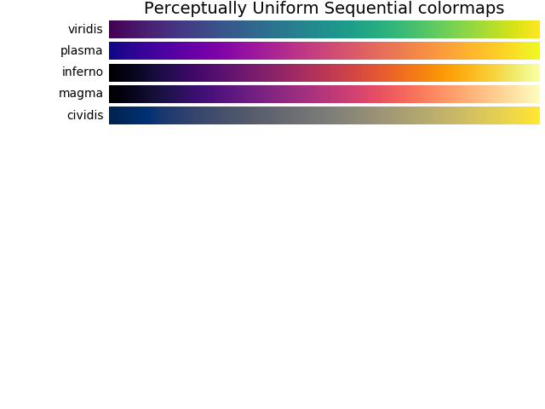
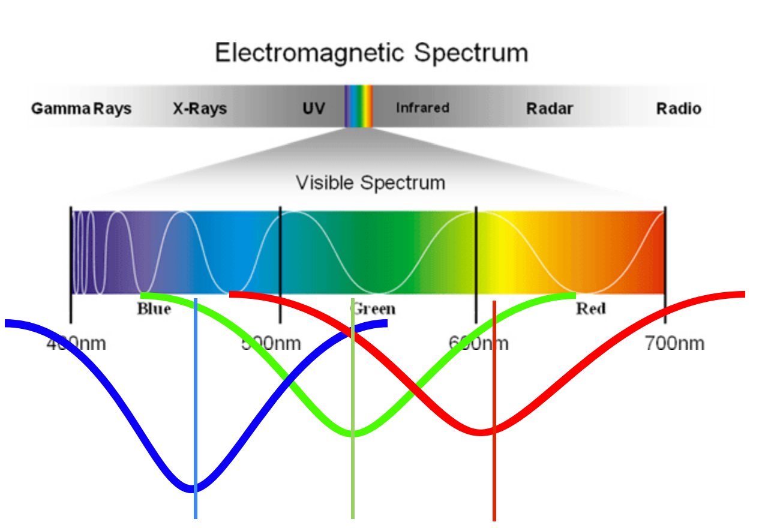
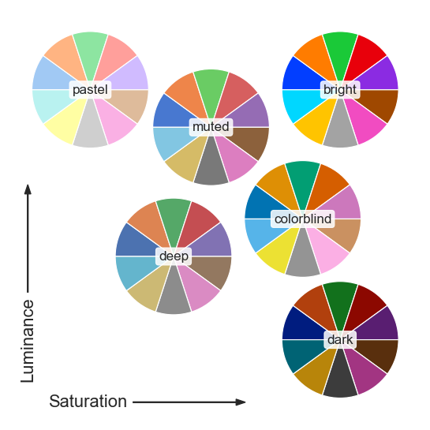
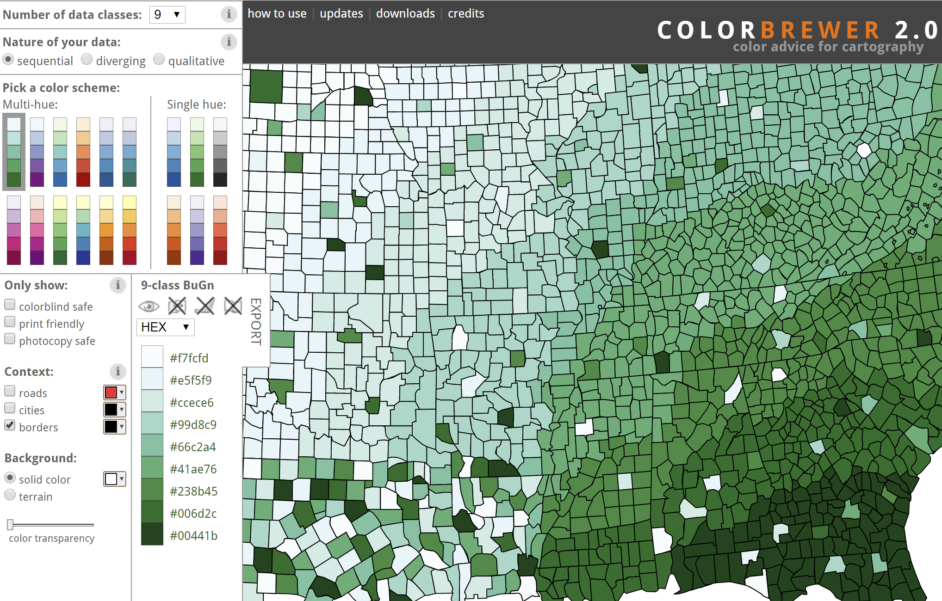
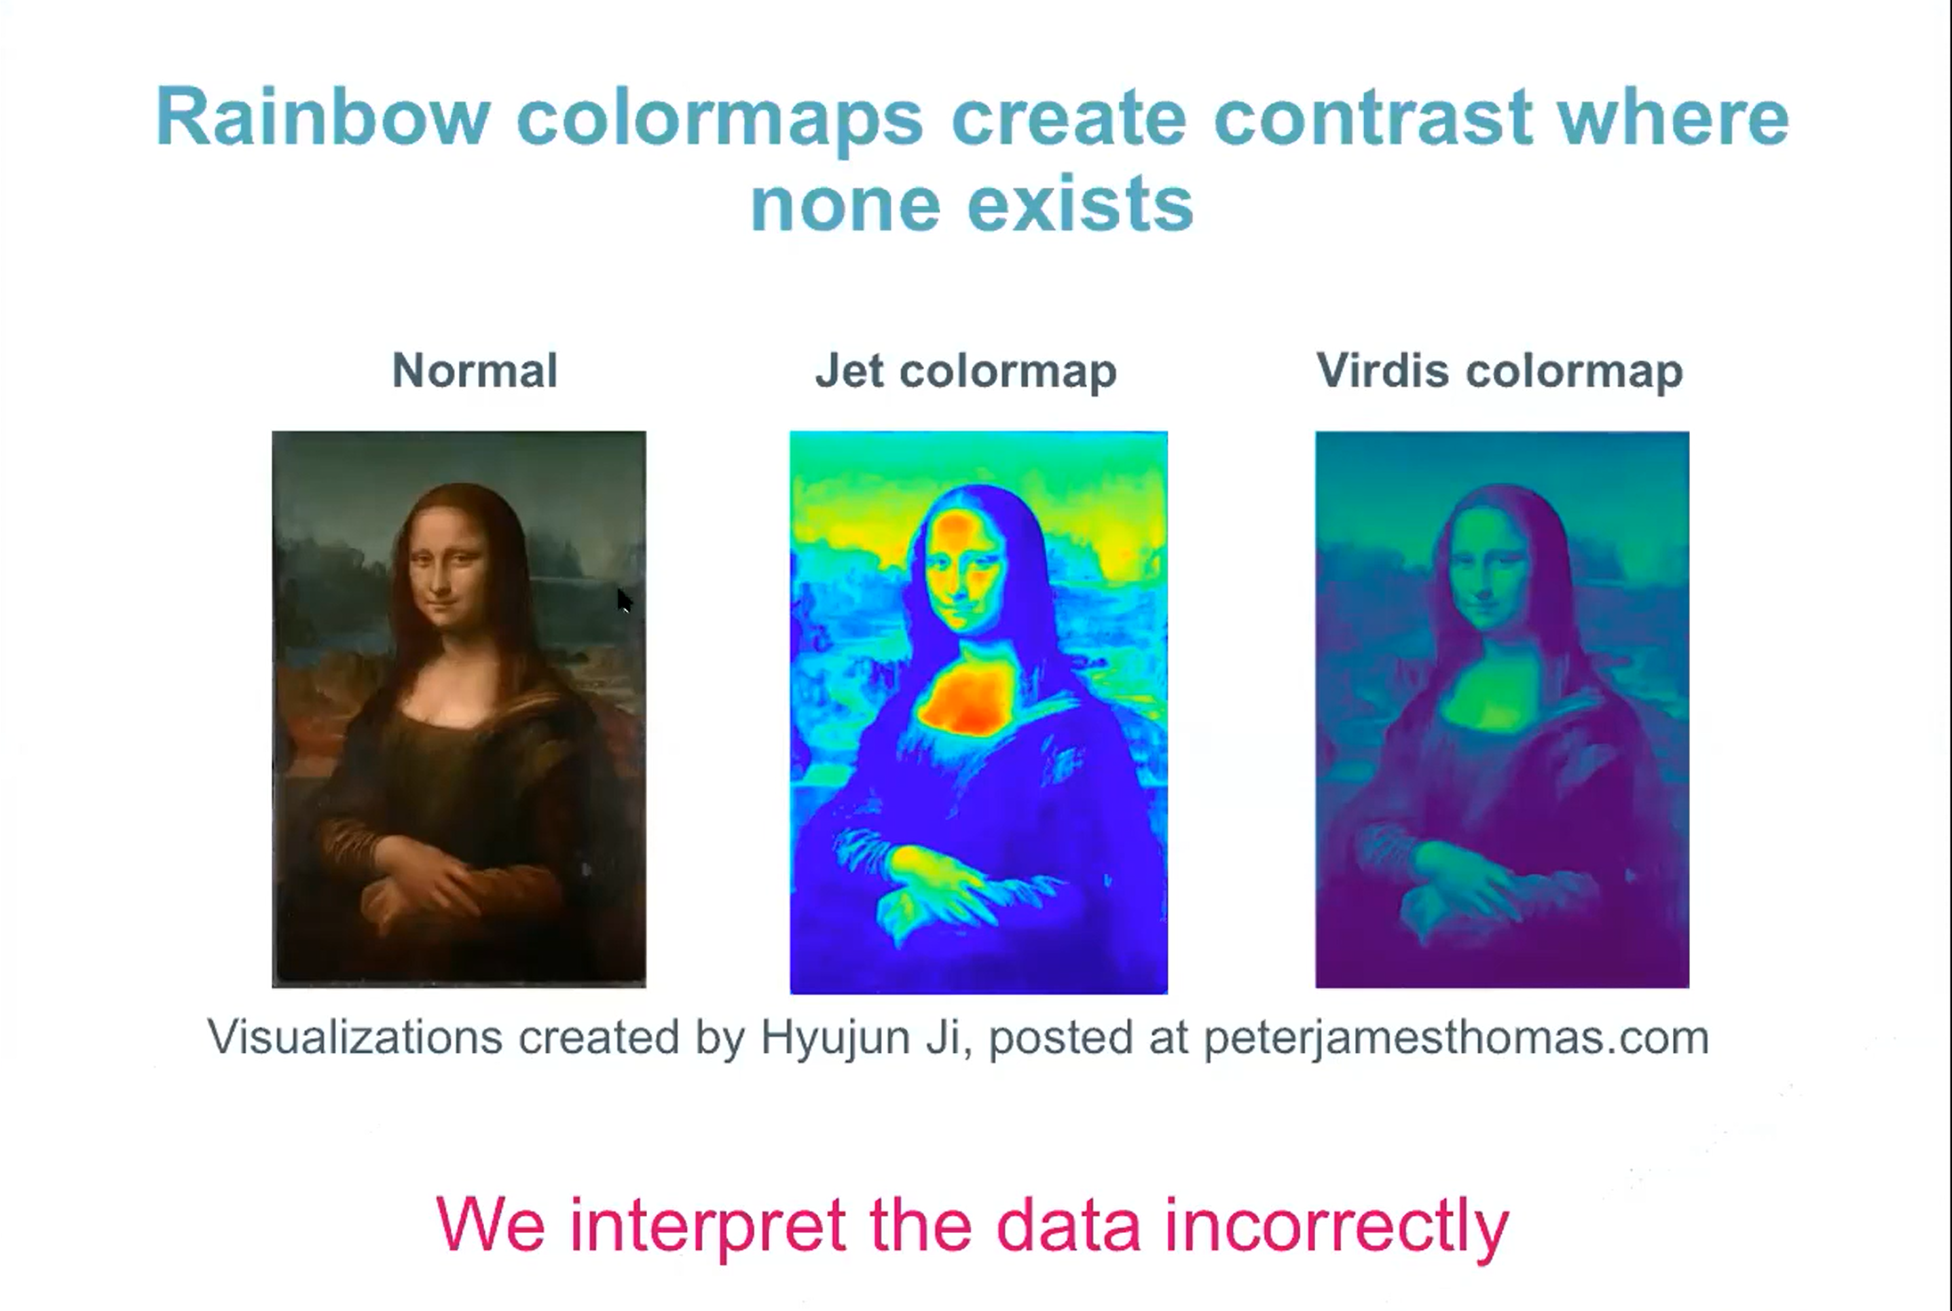
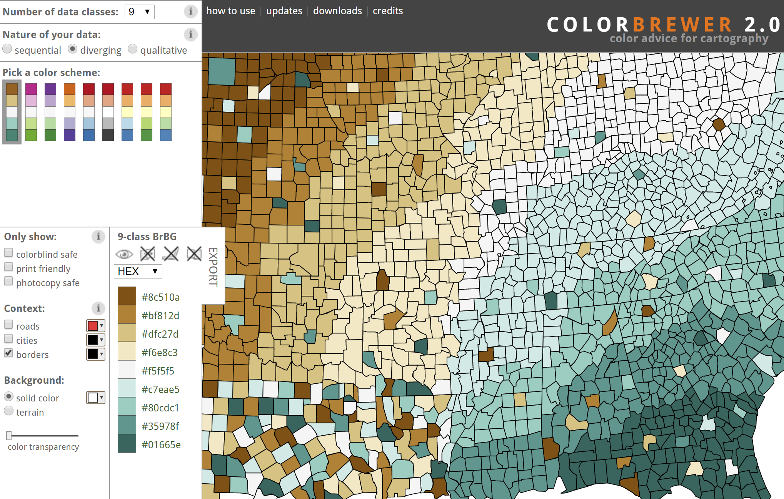
Effective plots – palettes
Sequential palettes – numerical low (uninteresting) to high (interesting)
Qualitative palettes - categorical
Danger zone
Diverging palettes – numerical low (interesting) to middle (de-emphasized) to high (interesting)

Slide 17
Effective plots – palettes
Qualitative palettes - categorical
Danger zone
Sequential palettes – numerical low (uninteresting) to high (interesting)
Diverging palettes – numerical low (interesting) to middle (de-emphasized) to high (interesting)

Slide 18
Effective plots
Effective figures in scientific papers should
immediately convey information about the study design and statistical analysis,
illustrate important findings, and
allow the reader to critically evaluate the data.²²

Slide 19
Mixed messages
Sample size
Central tendencies
Standard deviation vs confidence interval
Figure structure

Slide 20
Mixed messages
Sample size
Figure 6. Summary statistics are only meaningful when there are enough data to summarize.
Notes:
A, How the sample mean (red and blue dots) and standard deviation (red and blue error bars) might change if we repeated the same experiment 100 times, with n=5 or n=20.
The black line and gray shaded region show the population mean and standard deviation.
If all samples gave precise estimates, each sample mean would be on the black line and the error bars would fill the gray region.
B, How cumulative means change with increasing sample size. The sample mean is calculated for 3 participants. New participants are added 1 at a time. The colored lines illustrate how the sample mean changes as each new participant is added. The experiment is repeated 100 times. The black line shows the true population mean. When n is small, the sample means are often quite different from the population mean (“Seas of Uncertainty”).
As n increases, the sample means converge on the population mean (“Corridor of Stability”).
Interactive version: https://rtools.mayo.edu/size_matters/, Simulator 1.⁴² The terms “Seas of Chaos/Uncertainty” and “Corridor of Stability” were used in articles that examined the effects of sample size on correlation coefficients⁴¹ and effect sizes.⁴⁰

Slide 21
Mixed messages
Sample size
Figure 6. Summary statistics are only meaningful when there are enough data to summarize.
Figure 7. Small samples do not contain enough information to determine the distribution.
Notes:
Figure 7. Small samples do not contain enough information to determine the distribution. Random samples of different sizes (n=100, n=20, and n=5) were drawn from populations with a normal, skewed, or bimodal distribution (black violin plots). One can clearly identify the different data distributions when n=100. Determining the data distribution becomes more difficult when n=20 and is impossible when n=5. Interactive version: https://rtools.mayo.edu/size_matters/, Simulator 1.⁴²

Slide 22
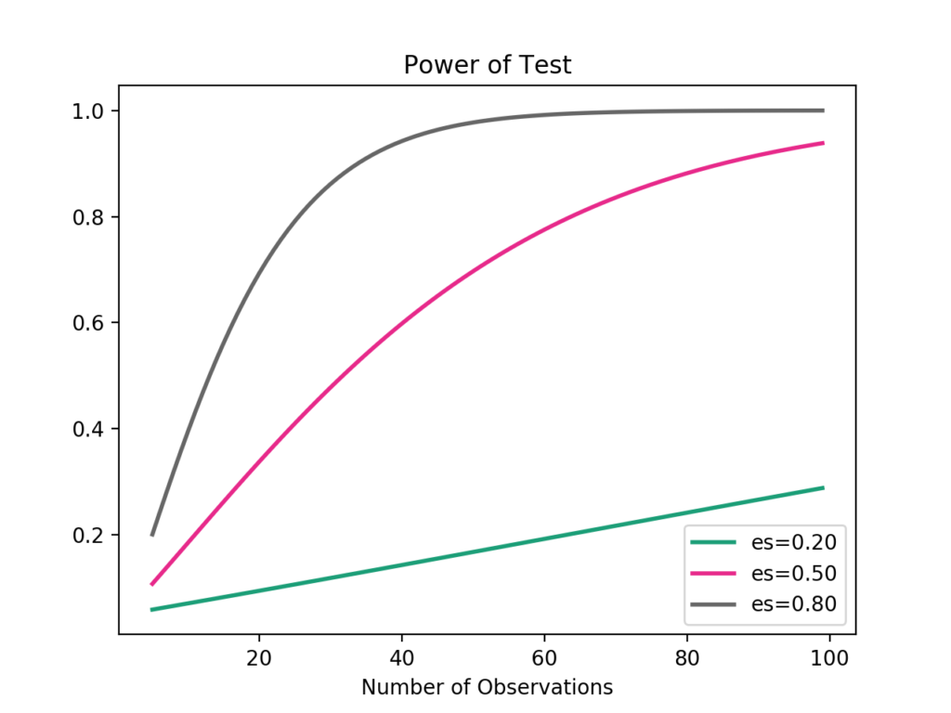
Mixed messages
Sample size
Power analysis
1 2 3 4 5 6 7 8 9 10 11 | # calculate power curves for varying sample and effect size from numpy import array from matplotlib import pyplot as plt from statsmodels.stats.power import TTestIndPower # parameters for power analysis effect_sizes = array([0.2, 0.5, 0.8]) sample_sizes = array(range(5, 100)) # calculate power curves from multiple power analyses analysis = TTestIndPower() analysis.plot_power(dep_var='nobs', nobs=sample_sizes, effect_size=effect_sizes) plt.show()
Notes:
Figure 7. Small samples do not contain enough information to determine the distribution. Random samples of different sizes (n=100, n=20, and n=5) were drawn from populations with a normal, skewed, or bimodal distribution (black violin plots). One can clearly identify the different data distributions when n=100. Determining the data distribution becomes more difficult when n=20 and is impossible when n=5. Interactive version: https://rtools.mayo.edu/size_matters/, Simulator 1.⁴²

Slide 23

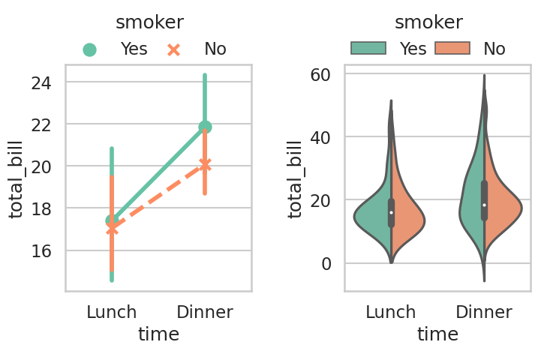
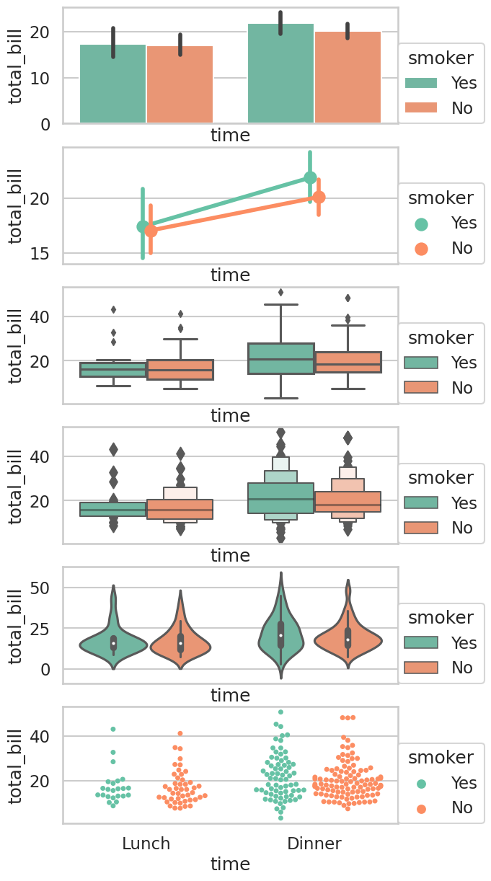
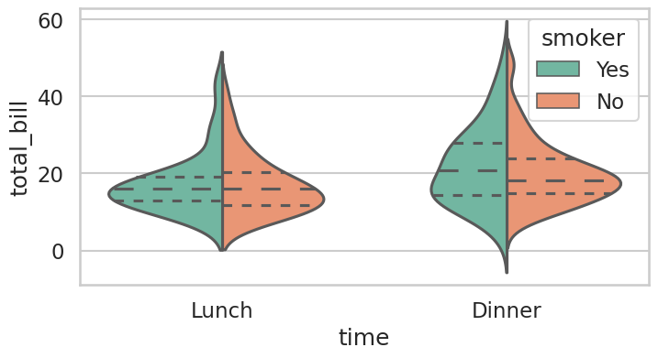
Mixed messages
Central tendencies
Standard deviation vs confidence interval
What do you want to show?
What is important about your data?

Slide 24
Mixed messages
Central tendencies
Standard deviation vs confidence interval
What do you want to show?
What is important about your data?

Slide 25
Mixed messages
Figure structure
Figure 8. Avoid sending mixed messages—why the figure structure should match the study design and statistical analysis.
Notes:
Figure 8. Avoid sending mixed messages—why the figure structure should match the study design and statistical analysis. The experiment was designed to compare normotensive and hypertensive patients. Separate analyses were performed for each dependent variable (biomarkers A, B, and C). A, A common strategy for presenting this type of data. Including all dependent variables on the same graph erroneously suggests that the authors intended to compare biomarkers A, B, and C. B, Avoids confusion by presenting each biomarker separately. HTN indicates hypertensive; and NT, normotensive.

Slide 26
Mixed messages
Figure structure
Figure 8. Avoid sending mixed messages—why the figure structure should match the study design and statistical analysis.
Notes:
Figure 8. Avoid sending mixed messages—why the figure structure should match the study design and statistical analysis. The experiment was designed to compare normotensive and hypertensive patients. Separate analyses were performed for each dependent variable (biomarkers A, B, and C). A, A common strategy for presenting this type of data. Including all dependent variables on the same graph erroneously suggests that the authors intended to compare biomarkers A, B, and C. B, Avoids confusion by presenting each biomarker separately. HTN indicates hypertensive; and NT, normotensive.

Slide 27
Resources and more examples
seaborn.pydata.org
data-to-viz.com

Slide 28
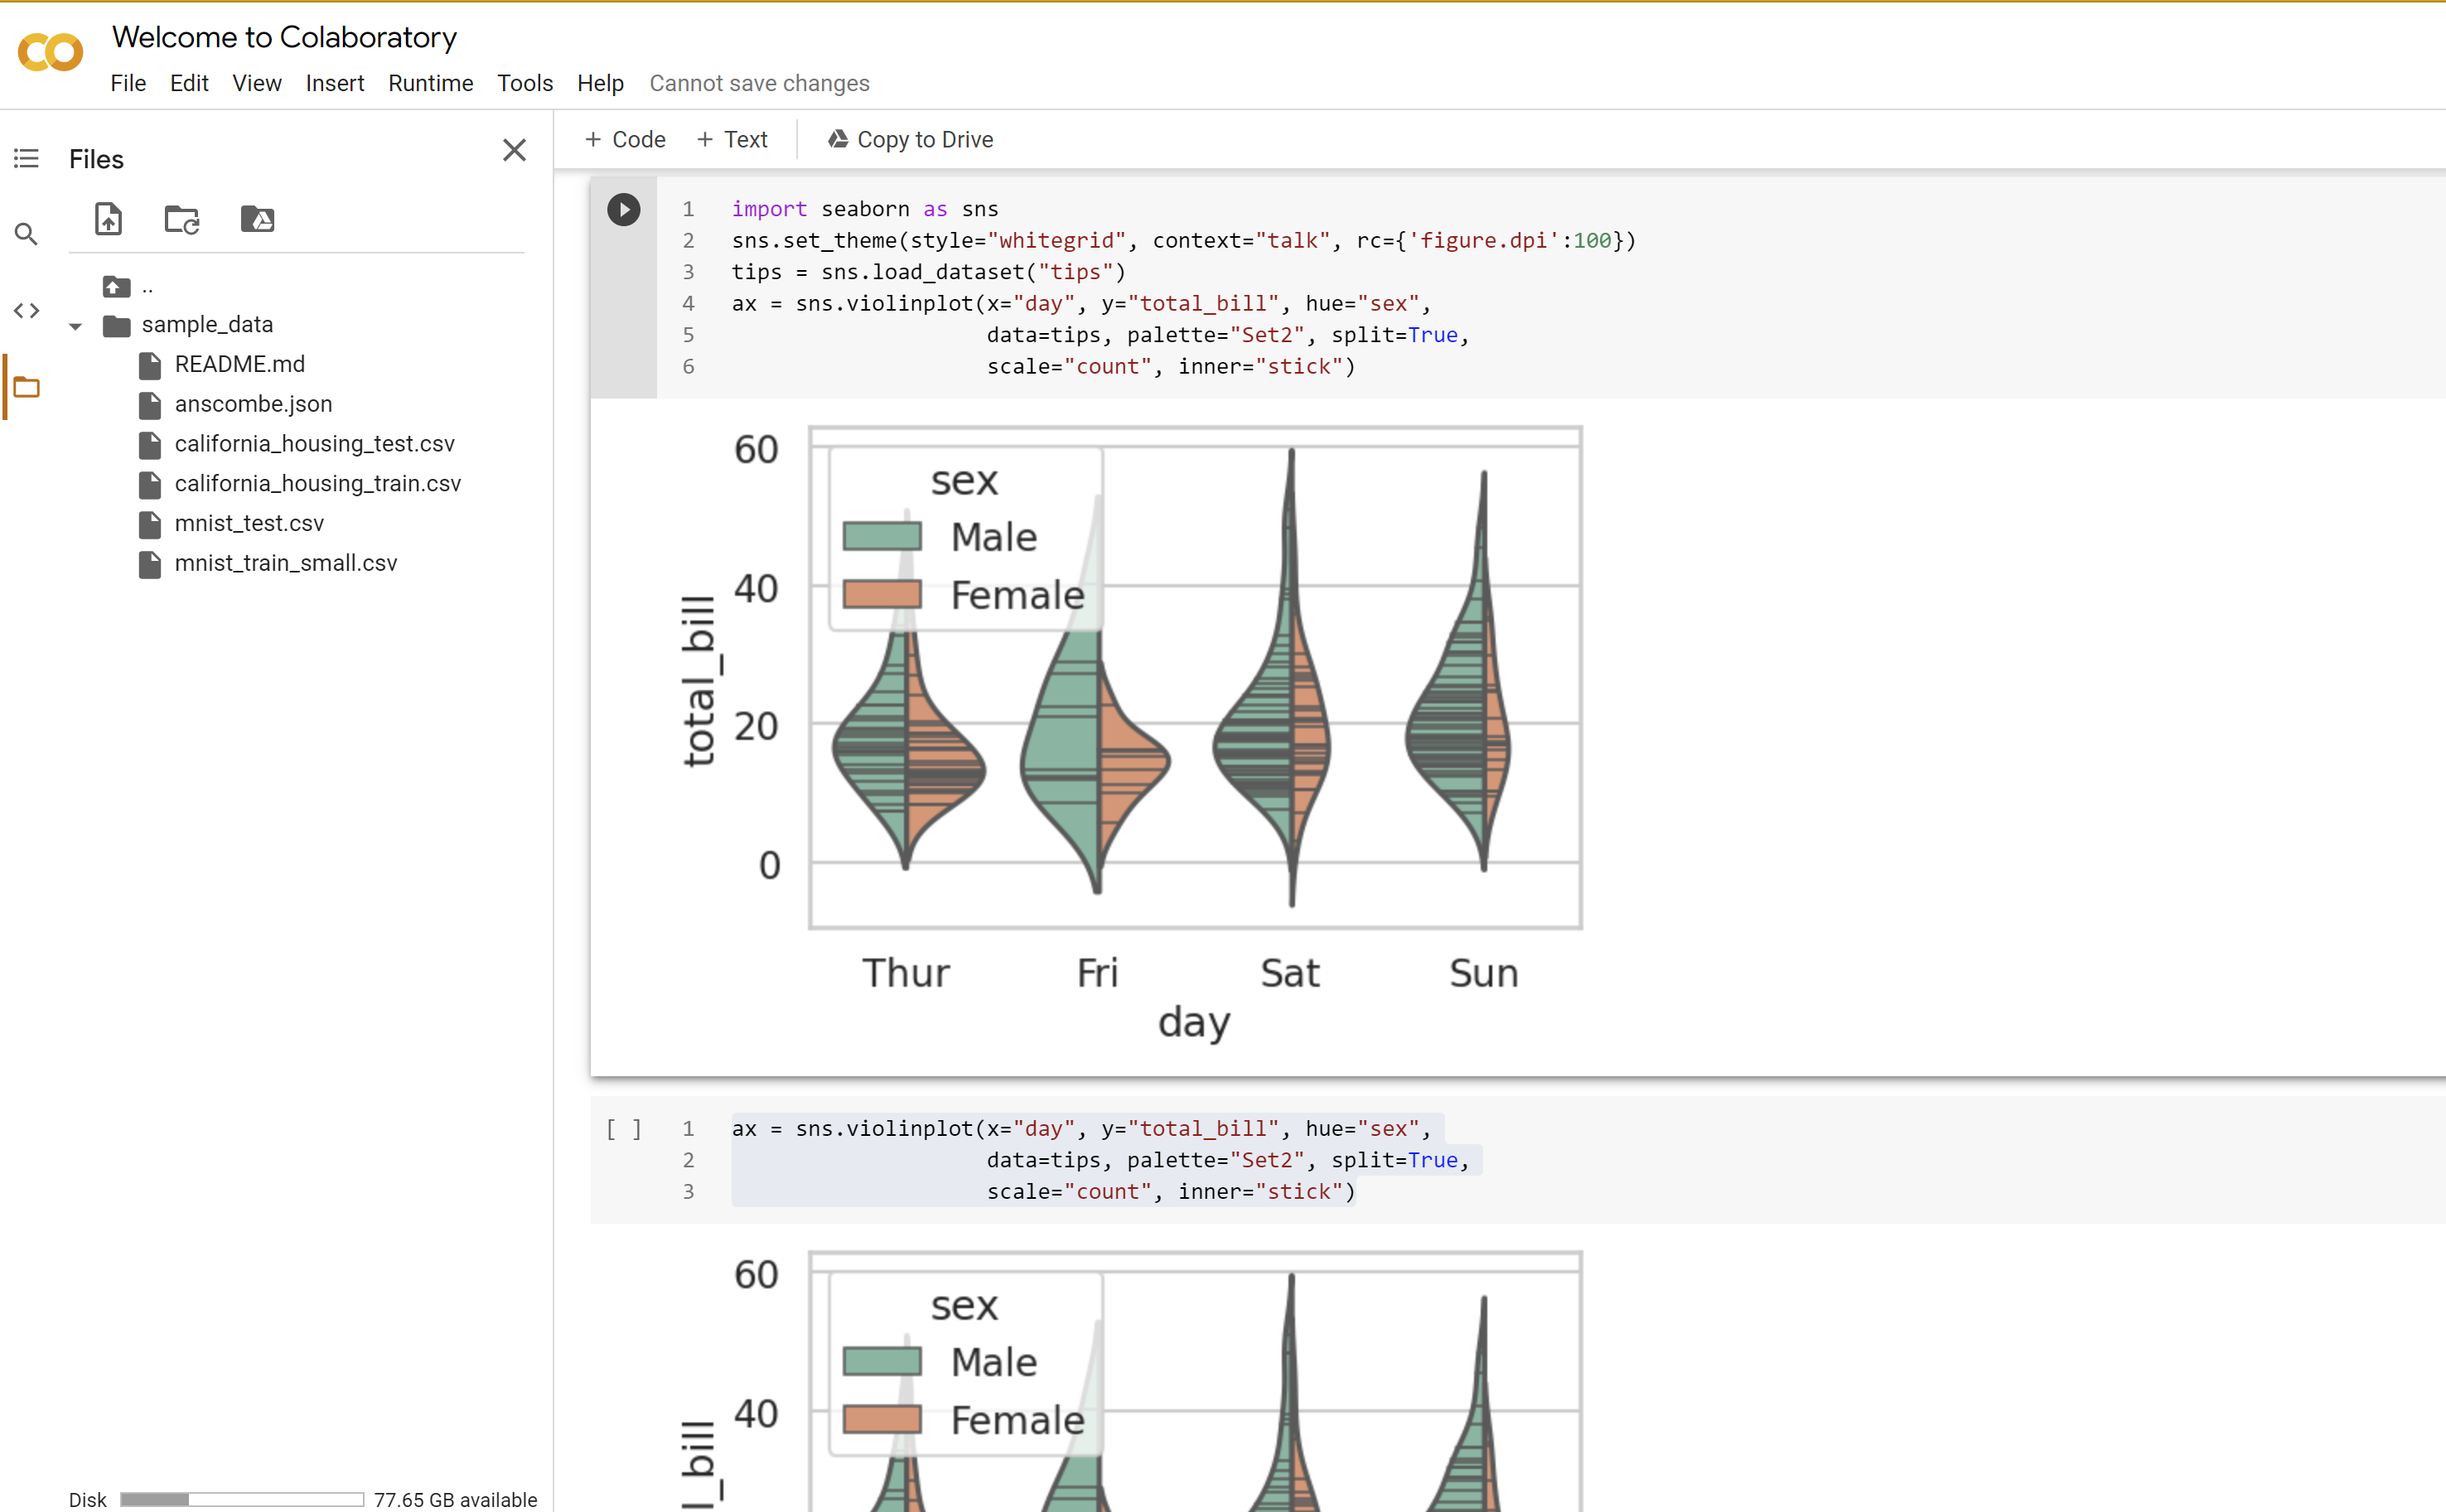


Principles
Authors
Readers
Expect to re-generate your figures multiple times: do you have a pipeline? How easy is it to adapt?
Use the tools you’re comfortable with, but make sure they’re capable – learn them well
Could the reader reproduce the data from your figures?
Do I need to be told what the figure shows? The figure legend should guide understanding, but by then opinions of the figure have already been formed

Slide 29
Aesthetics are not ‘art’, they are integral to making the figure work (“pre-attentive processing’).
Technical details are executed with care and perfect
Start small. Draw your figures by hand. Practice.
Develop a narrative for your figures. Every figure is a single sentence of the story.
Tell the story to a friend. Don’t use your hands while you are talking.
Know your target. Know the restrictions a journal puts on you before your start by heart.
Start with the biggest format of the intended journal. Cutting white space later is easy.
Make your panels. Leave the ink space to breathe.
Pay respect to words, numbers, drawings, and color alike.
Supply information on a need to know basis only. (Ask yourself, do they need to know?)
Get the alignment right.
No superfluous numbers, labels, clutter.
Fulfill expectations (Otherwise it’s cheating).
No axes boxes.
Outside tick marks.
Be consistent about your fonts and font sizes.
Make the line widths equal across all panels and figures.
When you can, don't use axes: Use scale bars - Make orthogonal curve joints.
Use the same axes and ranges in are comparable graphs.
Be consistent in your use of color throughout the paper.
Don’t get to excited about all your colors.
Histograms should be nice, similar but unique looking within a figure.
No chart junk, no decorations.
establish
build
change
compare

Slide 30
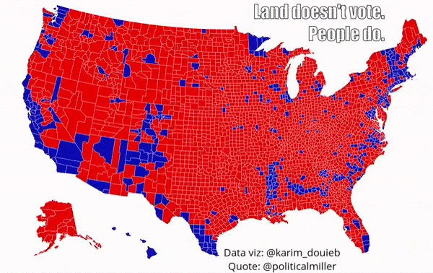

Slide 31
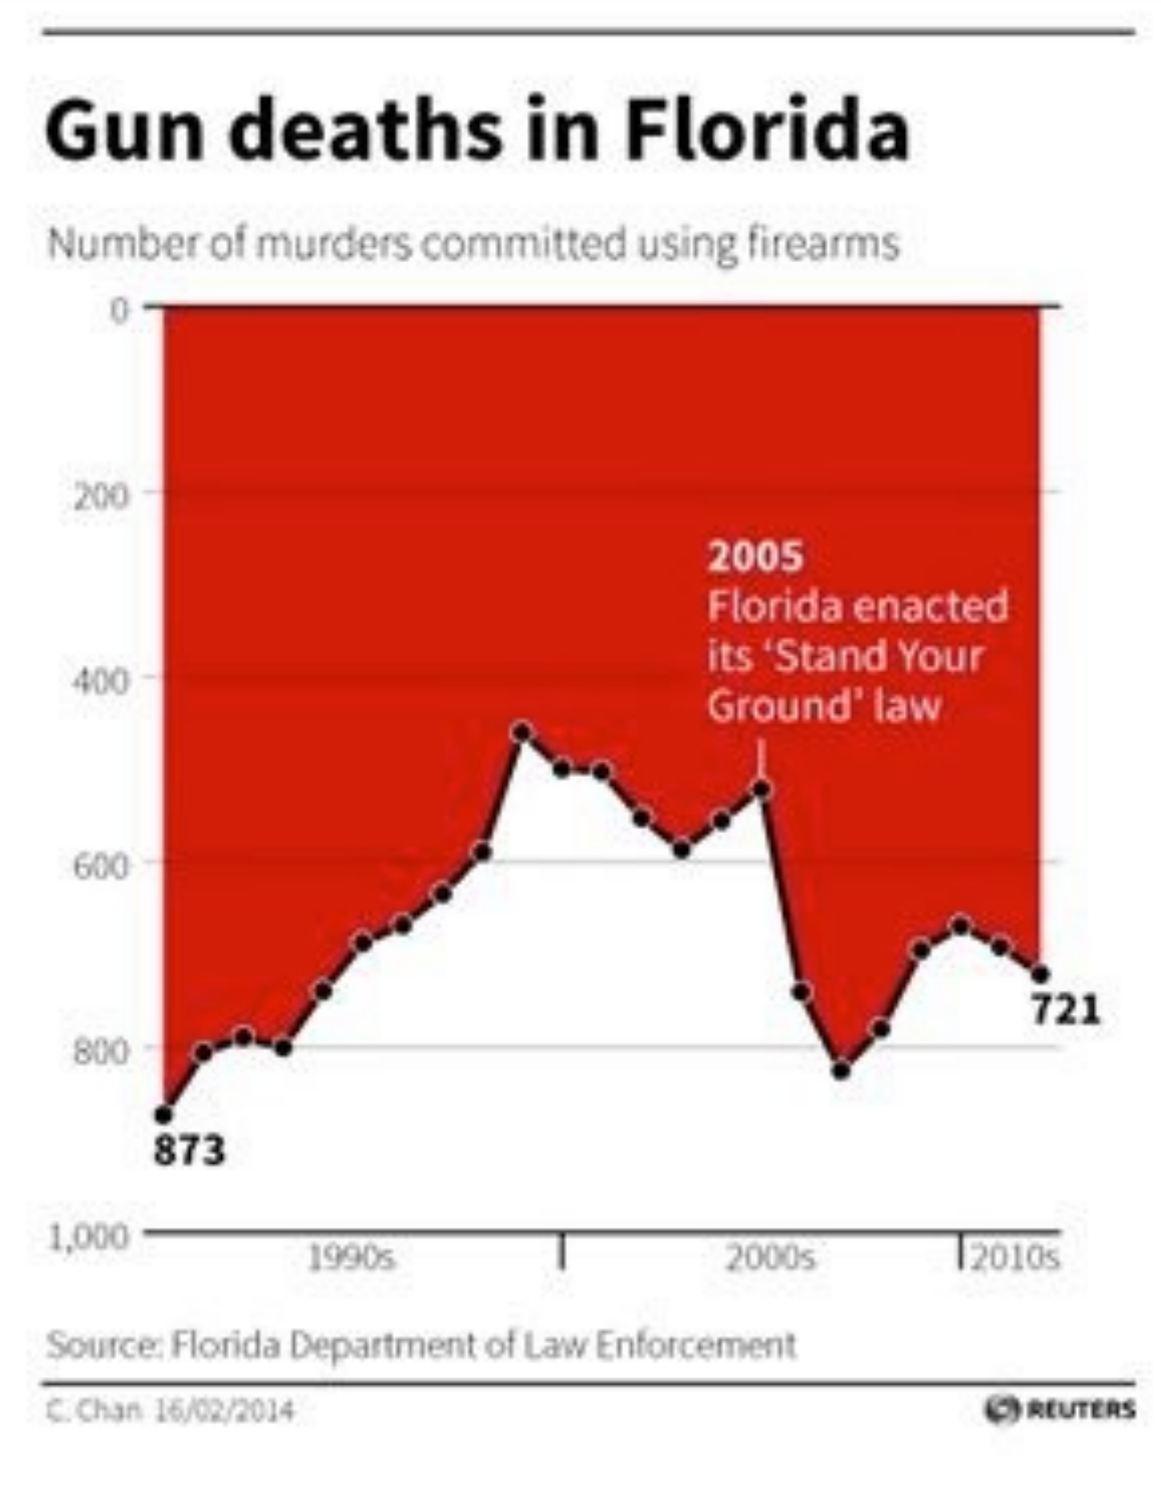

Slide 32
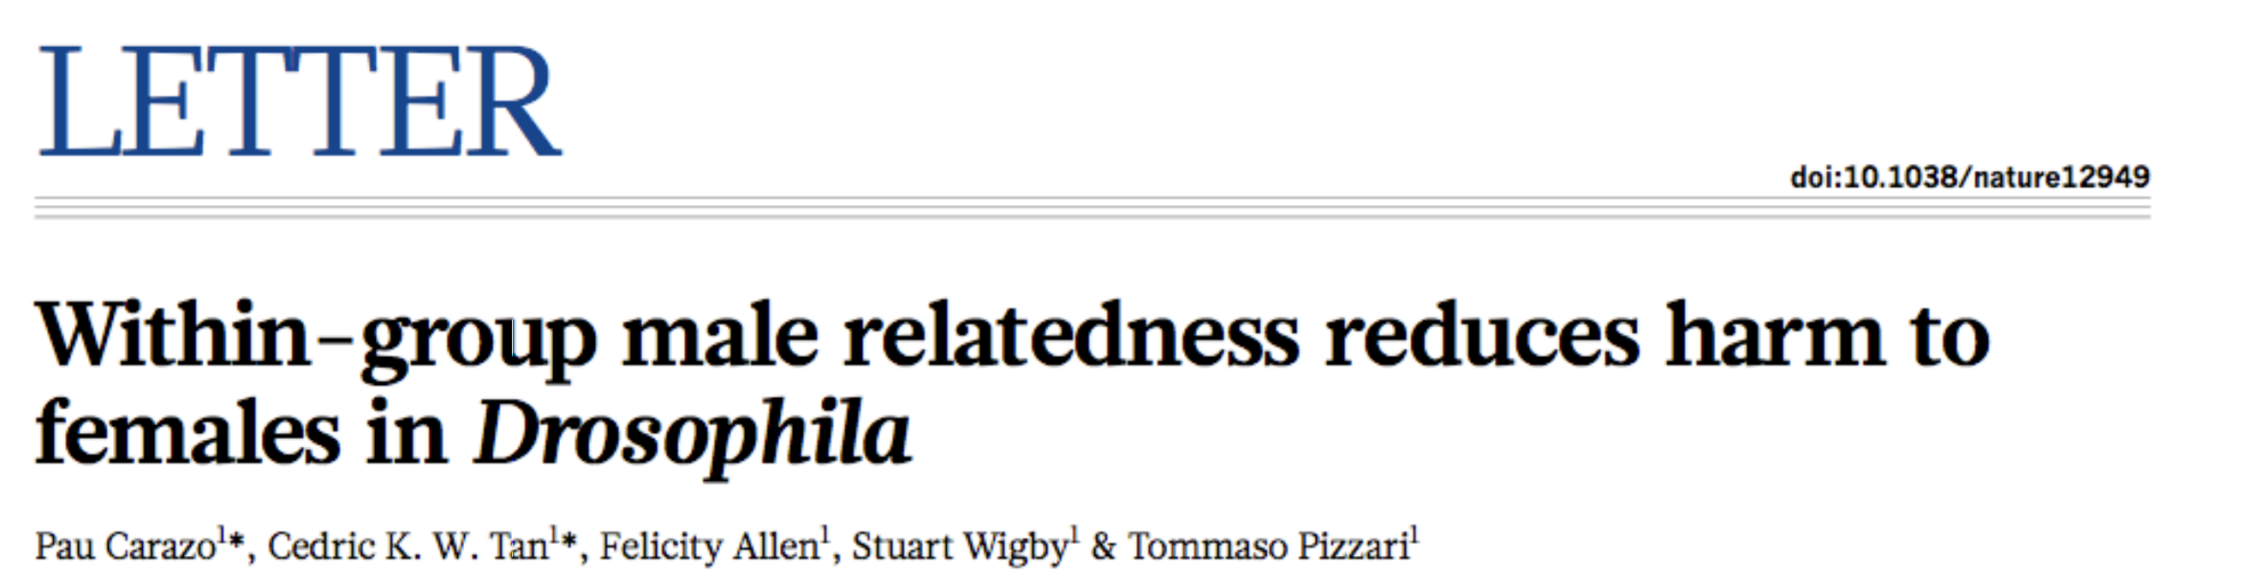
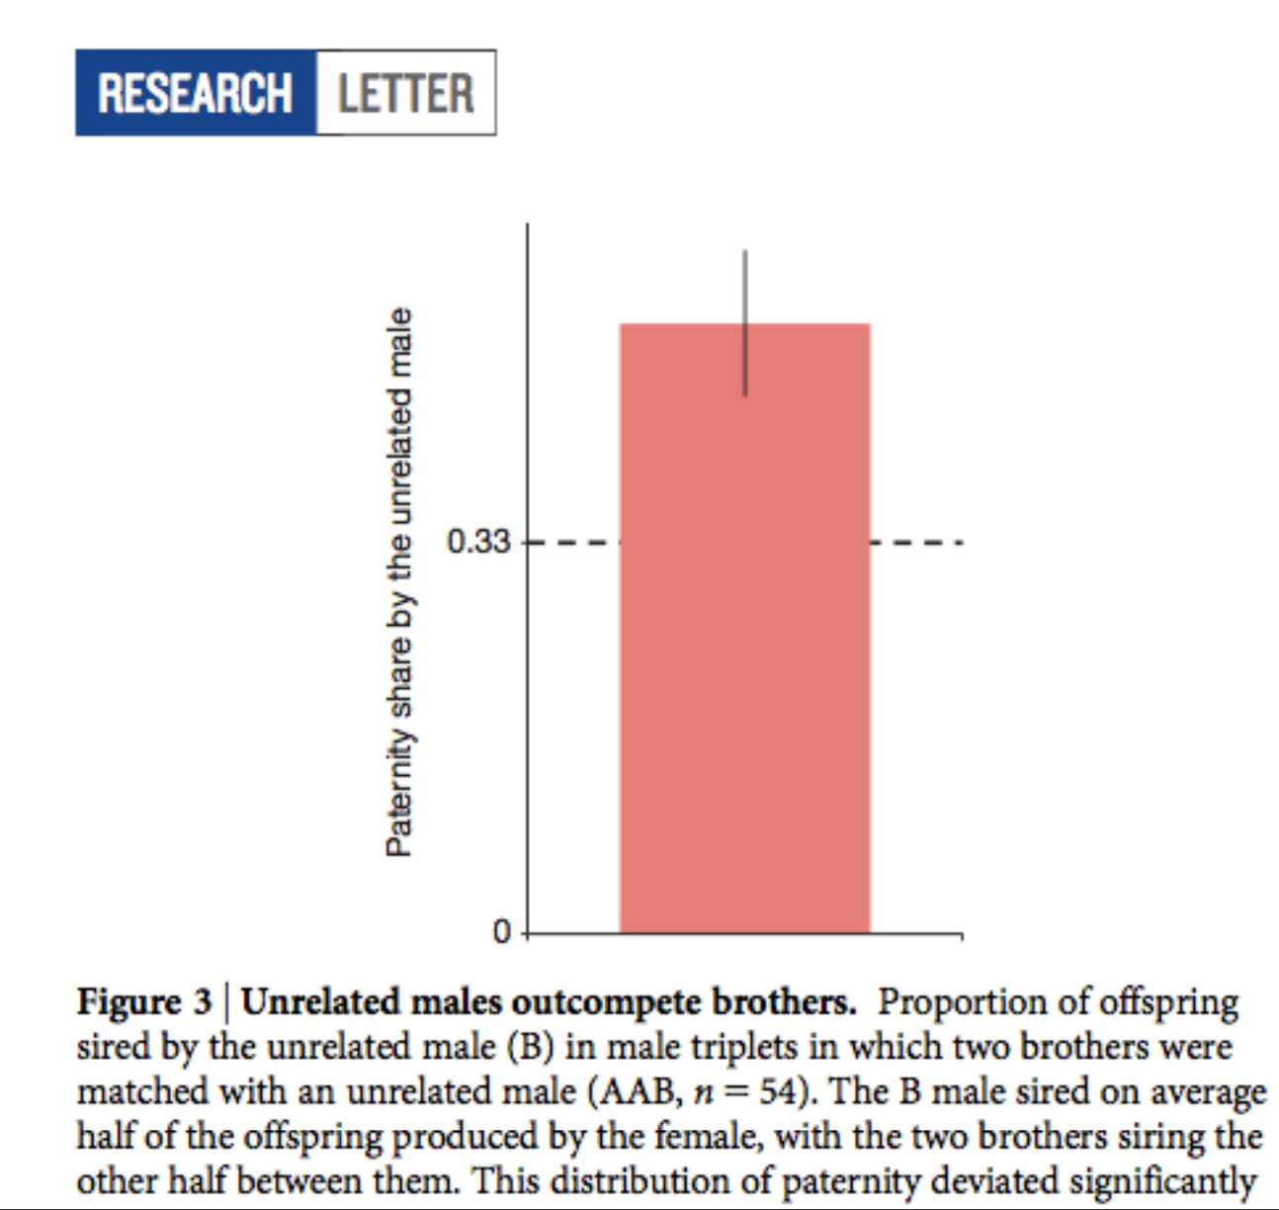

Slide 33
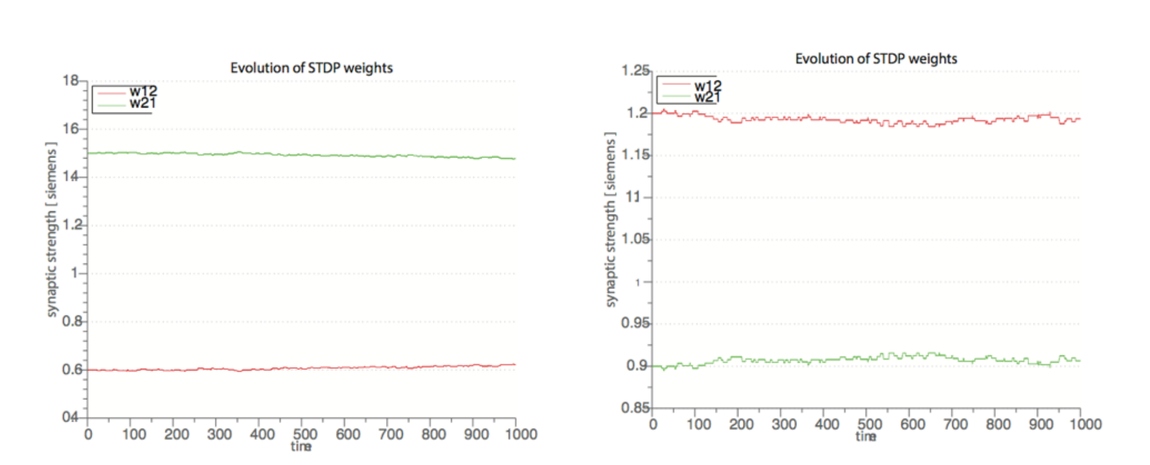

Slide 34
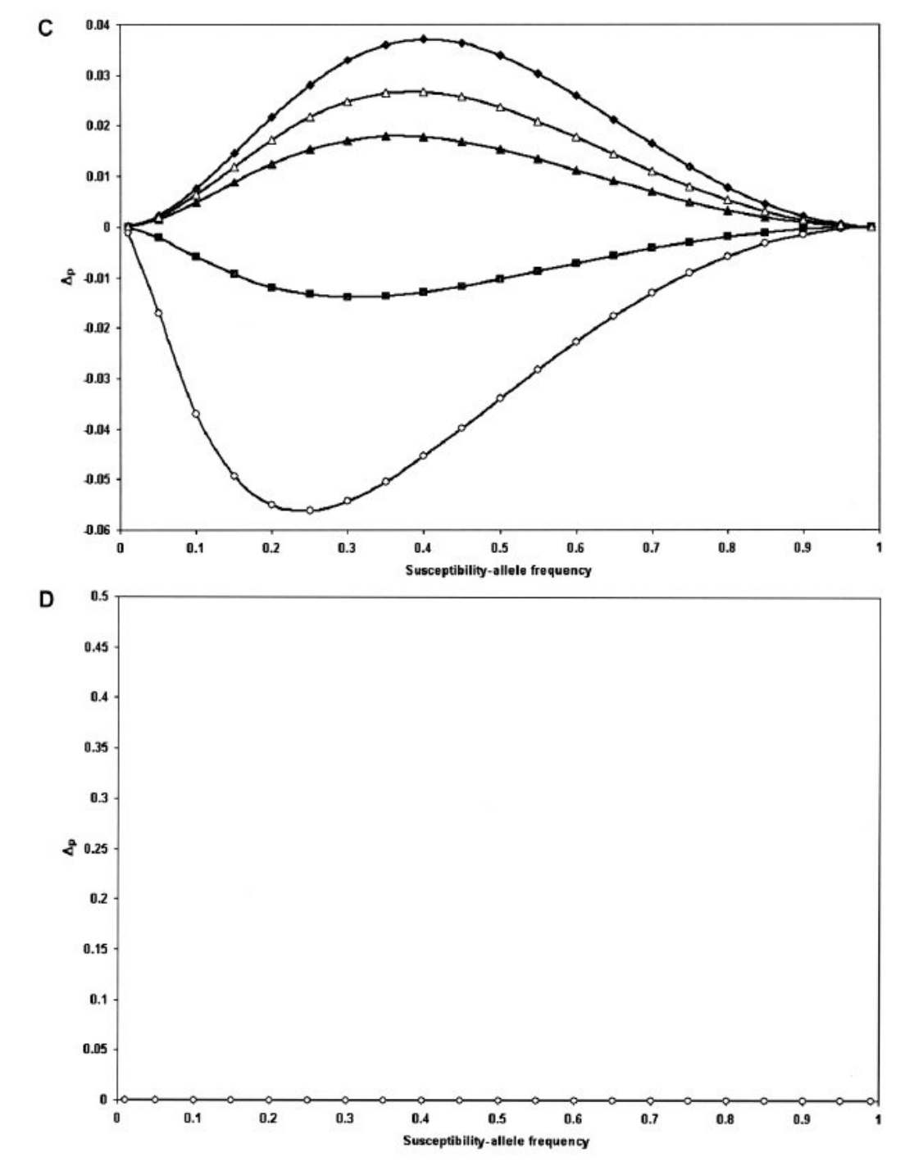

Slide 35
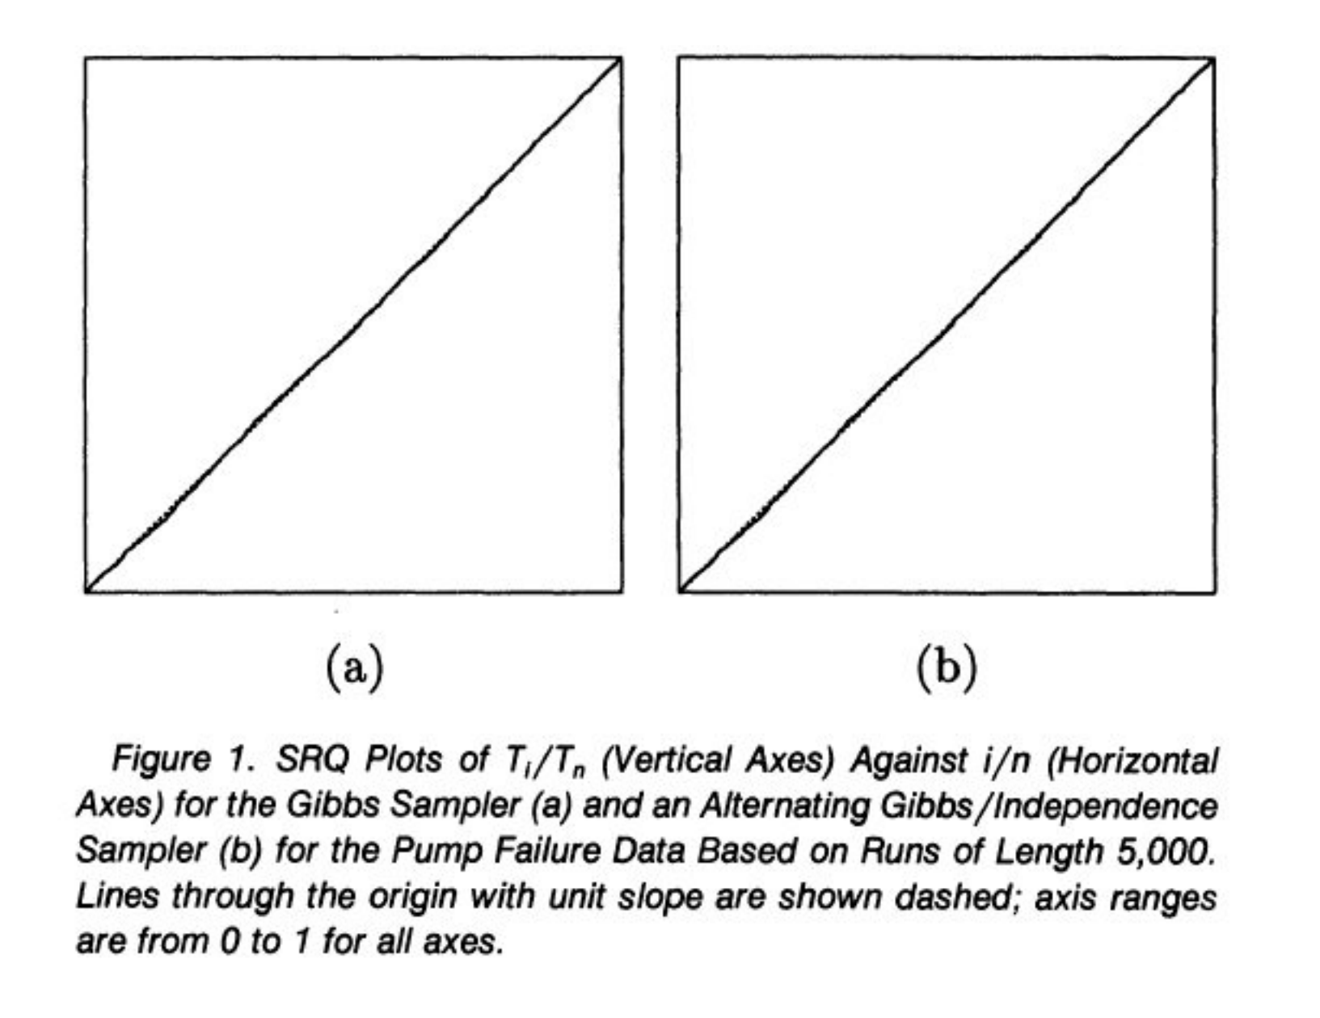

Slide 36
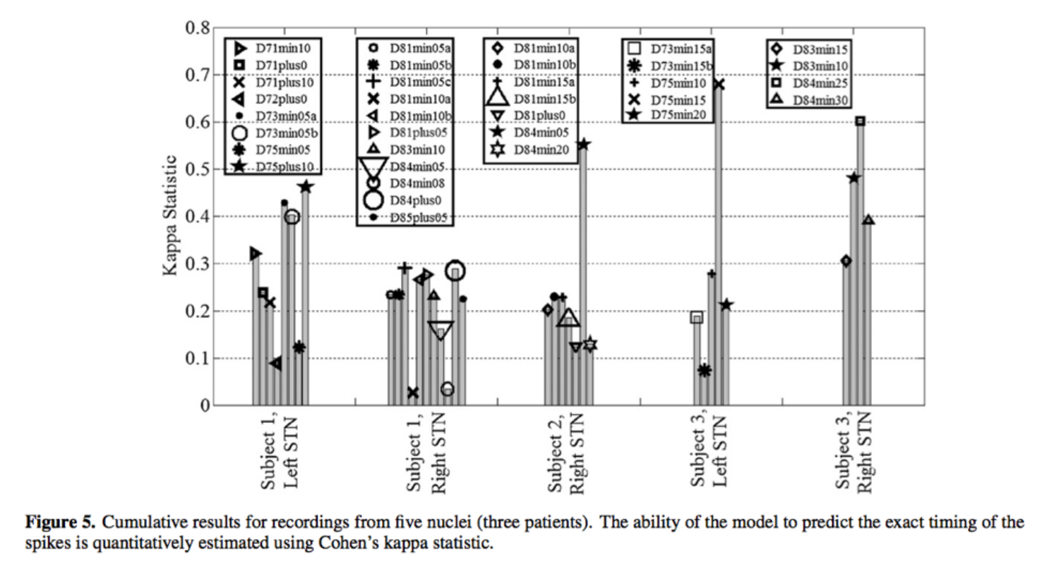

Slide 37
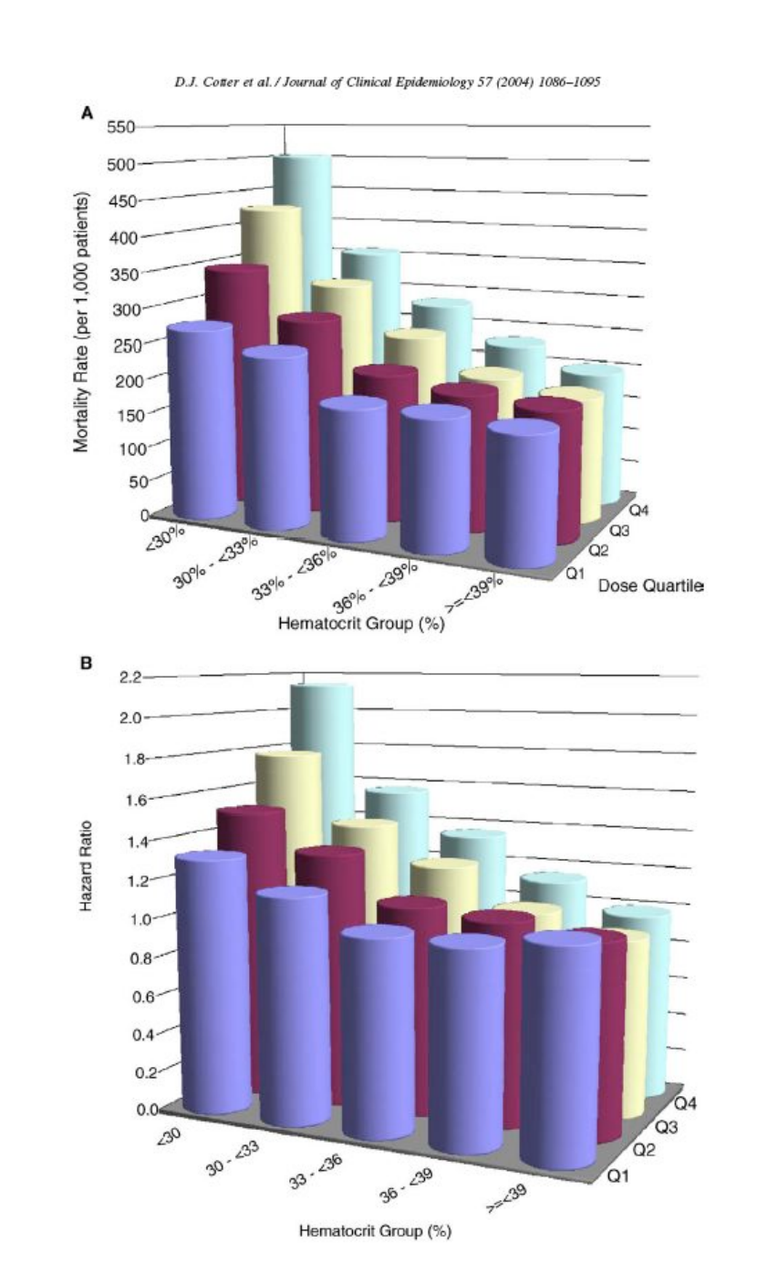

Slide 38
